Slide 1
ECD: Lessons from an HIV Care and Treatment Partner Evelyn Udedi and Alan Schooley, MD July 22, 2018

Slide 2
CONFLICT OF INTEREST
We have no conflict of interest to declare.

Slide 3
PARTNERS IN HOPE MEDICAL CENTER
Established in 2004 and has partnered with UCLA School of Medicine since 2006 - Staffing, Research, Programs
PEPFAR funded HIV Care & Treatment program since 2010
PIH played a large role in the startup of Option B+ in Malawi
91 sites supported, over 3000 health care workers trained.
Currently working in 101 facilities in eight districts in Malawi providing HIV Care & Treatment support to the MoH
Prominent role in diagnostics
TB Diagnostics
Viral load testing (largest lab in Malawi)
Set up 3rd Line ART and Genotyping program for the MoH
Hilton Partner since 2015

Slide 4
IMPACT OF THE HIV EPIDEMIC ON HEALTH SYSTEMS
Ministry of Health focus on HIV creates gaps in other necessary programs
Impact of PEPFAR is particularly important given the new focus on epidemic control and decreasing support for other important services
Funding is rarely pushed to programs that only have long-term measurable outcomes
Easy to measure DNA-PCR testing, but harder to measure the number of children that are able to meet their life goals

Slide 5
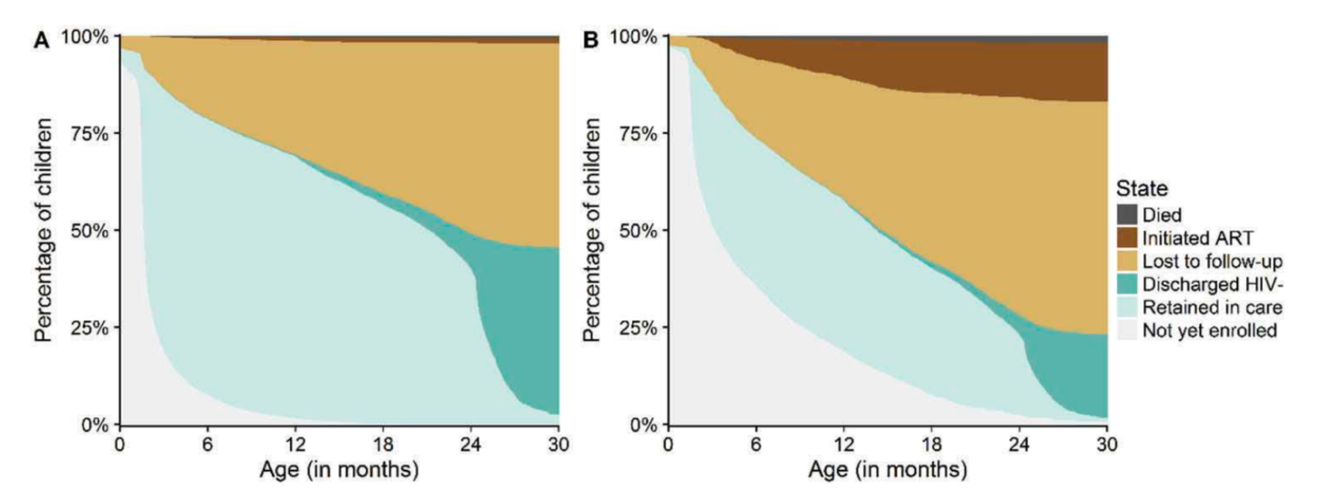
OUTCOMES OF THE EID PROGRAM IN MALAWI
11,285 exposed Infants
82% born to mothers on ART (Option B+)
2.6% with known HIV transmission
At 30 months of age 57.9% were lost to follow-up
Estimated 5.3% infected
Haas AD et al. Journal of the International AIDS Society 2017, 20:21947 http://www.jiasociety.org/index.php/jias/article/view/21947 | http://dx.doi.org/10.7448/IAS.20.1.21947
Notes:
fine

Slide 6
CLINICAL IMPORTANCE OF DOING MORE THAN JUST HIV CARE
Importance in other health settings to ensure that families learn how to foster brain and physical development and for children to develop as much as possible.
Easy to win the battle and lose the war
High income countries provide developmental support for children at risk for delays due to other illnesses: Oncology, chronic diseases, genetic diseases, etc. as part of holistic healthcare.
ECD is not on the Dock
Notes:
???? Do we keep this slide???? The ECD not on the dock phrase and the picture

Slide 7
SOCIAL DISEASES
Don’t go away because of better medicines, although it does help!
Multiple inputs/Multiple outputs
Epidemic Control if not monitored carefully can lead to focused outcomes but may miss out on other necessary inputs that are critical to control the epidemic over the long term
Most importantly, we can miss opportunities to improve overall health due to myopia
Notes:
Could be removed as doesn’t add much to the presentation

Slide 8
Challenges for Care and Treatment Teams
PROBLEM | SOLUTION
VERTICAL PROGRAMS: Multiple visits for health services due to lack of integration | Expand access to other health services (e.g. non-communicable diseases) to encourage patients to access their clinic which will lead to better health.
MEN Don’t feel comfortable coming to the clinic (implies HIV+ status) | Create other reasons to come the clinic. Encourage men to come to clinics with their wives and young children, NCD Clinics
LIMITED SPACE Long waits for healthcare | Community ART Distribution Differentiated Service Delivery
MESSAGING Insufficient time to provide comprehensive health messages | Strengthen community messaging. Often needs an outsider to start the the process of change
EXPOSED INFANT CARE/DIAGNOSIS | Strengthen Mother-Infant Pair Clinics
C&T Teams

Slide 9
Integration of ECD and HIV Care
The problems are the same!
Mothers need support from other mothers
Husbands need support from other husbands
Husbands and mothers need to support each other
Parents can rally around their children
HIV programs are pushing to increase men’s access to care, but men are scared go to health facilities. (unpublished data)
Getting men into HIV care is critical, but we have to drive community norms that lead parents to do the right thing.
Notes:
Need notes , but no slide

Slide 10
Early Childhood Development in Malawi
Malawi’s Strategic Plan
Aims to facilitate the implementation of the National ECD policy by providing adequate care, support and protection
3 approaches for providing ECD:
- Multi-sectoral approach
- Lifecycle approach
- Human rights based
Notes:
Move investing in the child’s early years

Slide 11
Integrating Early Childhood Development into Option B+ in Malawi

Slide 12
BACKGROUND
WOMEN LIVING WITH HIV
EXPOSED INFANTS
Encounter multiple vulnerabilities
Adherence to ART
Early identification
Quality of life
Equally vulnerable
Early identification
Retention in ART program
Development and growth

Slide 13
PROJECT OBJECTIVES
Integrate ECD skills within the HIV clinics for Option B+ mothers
Determine whether the ECD interventions enhance retention in care for women living with HIV
Evaluate the feasibility and sustainability of engaging community volunteers to implement ECD interventions

Slide 14
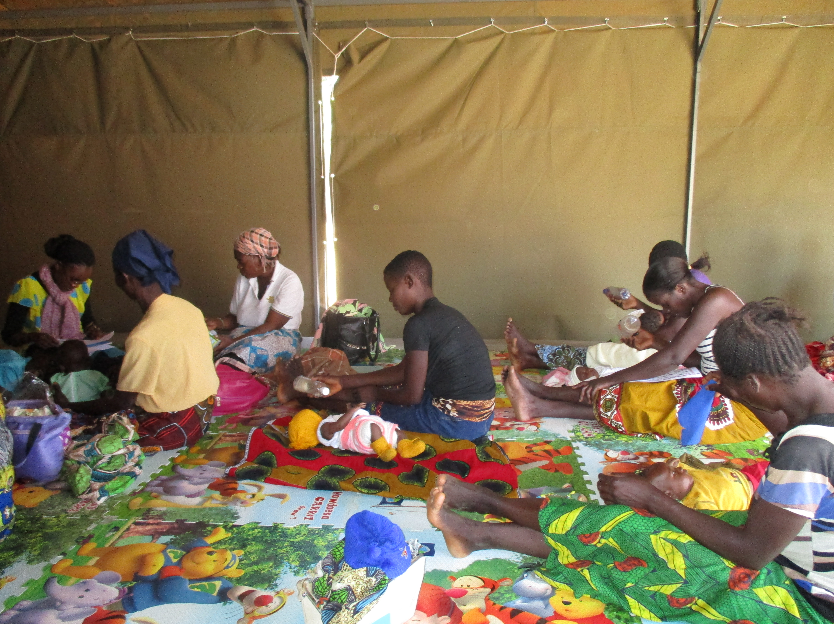
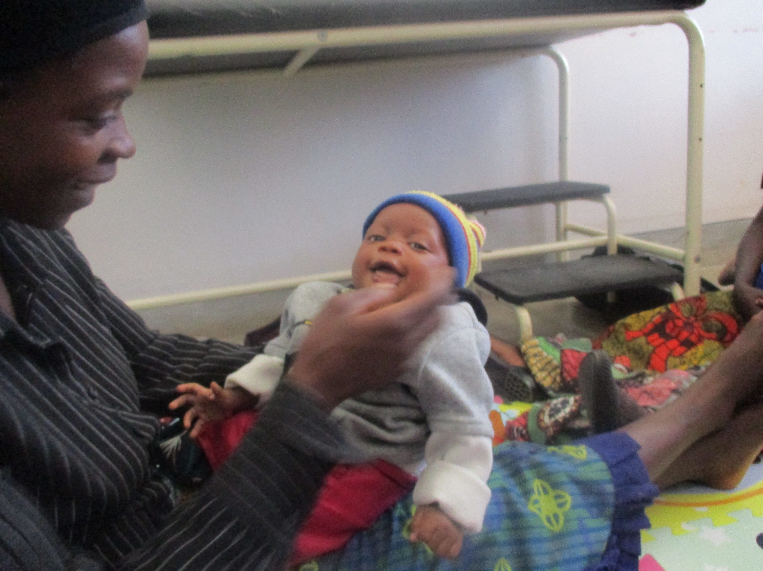
Methods
Pilot program conducted in 2 district hospitals with Option B+ mothers and their infants aged 6 to 8 weeks
Recruited from March to December 2016
Data on important HIV & ECD variables were collected at enrolment and at the end of the program
ECD skills sessions conducted for 9 consecutive months on days that coincided with routine mother-infant pairs ART appointments
Using the Care for Child Development Curriculum (WHO/UNICEF)
Interactive (demonstrating play, stimulation and communication)
Notes:
Pregnant women > 18
Known or newly diagnosed HIV status
No plan to leave the area
No significant developmental delay at six weeks
Consent given
Mothers were assessed for eligibility at ANC and maternity, those that fulfil the criteria were invited to participate and appointed to come at 6-8 weeks.

Slide 15
RESULTS – Phase 1
Of the 149 Option B+ mothers enrolled in the program, 114 (77%) graduated
96 (84%) of enrolled MIPs attended all > 8 of the 9 sessions
Trained volunteers led two cohorts
95% of interviewed graduate mothers reported improved ECD skills after participating in the program
Exit home visits showed >90% of infants had appropriate stimulation and communication from care-givers at home
Of the 24% infants having moderate developmental delays at initial assessment, 94% moved to normal at follow-up assessment
Mothers believed the intervention improved waiting time, ART services and allowed them to access multiple services at one visit
90% of 10 cohorts retained on ART 3 months post-graduation

Slide 16
Change in ECD related Variables at the End of the Program (Data from Home Visit and Questionnaire)
Variables | Baseline | Follow-up
Mother’s knowledge of ECD stages | 53% | 93%
Books available for the child in home | 19% | 54%
Homemade toys available in home | 42.6% | 85%
Child plays with household objects | 31% | 85%
Reading books to the child | 14% | 73%
Telling stories to the child | 55% | 95%
Singing songs to the child | 19% | 90%

Slide 17
MINISTRY OF HEALTH SUPPORT
Integration in government and mission health facilities
Training on basic HIV care for mothers and infants attending clinics
Working with expert clients
Training providers on ECD package

Slide 18
LESSONS LEARNED
ECD/ Option B+ integration is feasible and fits in well within government structures and creates an opportunity to address ECD and retention in ART
HIV positive mothers have shown interest and involvement, though mobility remains a challenge
ECD/ Option B+ integration results in improvement of caregiving, though male involvement remains minimal
Use of community volunteers may be a feasible solution to sustainability (ease of model; positive feedback)
Some vulnerabilities still exist
Inability to disclose status to close family
Burden of caring for extended family
Community level stigma
Notes:
Out of place and maybe not useful

Slide 19
Expert Client Model

Slide 21
MIP Clinics (Model 1)
Mother Infant Pair Clinics
Used to increase uptake of HIV related services.
PMTCT
DNA-PCR testing
Improvements in Retention in HIV care due to added service of ECD
Promoting play, communication and stimulation
Specific day once a month (reduces frequency of visits)

Slide 22
ECD in the community (Model 2)
Community norms needs to change if ECD is to be fully implemented. Mothers need to teach other mothers.
Traditional Authorities need to push the agenda, but that can’t happen at a health facility
Use of existing community outreach clinics
Health Talks integrated ECD messaging

Slide 23
Invites for community to come the facility (Model 3)
Change Theory :
Health Centers are not only for when you are sick.
Also requires support from Traditional authorities to keep communities well informed
Men are late in accessing care
Need to create reasons for men to be in the clinic

Slide 24
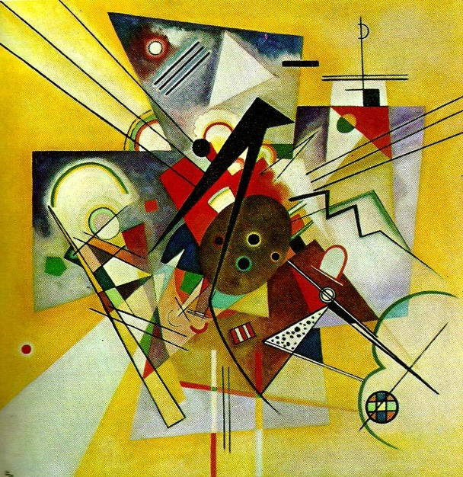
Painting with Watercolors
Yellow Accompaniment
Wassily Kandinsky
Misty Morning
Painter unknown

Slide 25
Painting with Watercolors: Integration of ECD and HIV
Key activities that everyone can do:
Ask questions, don’t be bashful
Ensure that children and their families are tested for HIV
Ensure that families are staying in care
Support families in HIV care as part of ECD activities
Ask if they are going to appointments
Setup referral systems for families that drop out of care
Work with health facilities to identify families that are at risk
Know the testing schedules for DNA-PCR and follow-up Rapid HIV testing
Find ways to use “wasted time” inpatients in waiting areas
Community norms make a difference – be agents of change

Slide 26
Thank you!

